Slide 1
Reformasi Sektor Kesehatan di Dunia dan di Indonesia
Sesi 3

Slide 2
Isi
Bagian 1.Memahami Reformasi Kesehatan
Bagian 2. Apakah kebijakan financing saja cukup? Kasus Jamkesmas
Bagian 3.Conctracting sebagai salahsatu kebijakan dalam reformasi kesehatan

Slide 3
Bagian 1. Memahami
Reformasi Kesehatan

Slide 4
Health sector reform:
“...sustained, purposeful, strategic change to improve health system performance”
--Peter Berman
“… perubahan yang berkelanjutan, bertujuan, dan stratejik
untuk meningkatkan kinerja sistem kesehatan “

Slide 5
Mengapa Dilakukan Reformasi?
Pendekatan “Negara Gagal”

Slide 6
Negara gagal dan Konsekuensinya
Organisasi Tradisional Sektor Publik
Sifat:
Produksi langsung
Monopoli dan Koordinasi
Kontrol kementrian yang kuat
Karakteristik organisasi:
Departementalisasi dan hirarkis
Karir dalam layanan publik
Sentralistis
Konsekuensi
Pengambil keputusan memperoleh insentif yang kurang mencukupi untuk bertindak secara efisien➔ property rights theory.
Pihak yang mengendalikan birokrasi mungkin tidak bertindak untuk kepentingan publik➔ public choice theory.
memperkenalkan mekanisme pasar (misal: kontrak)
➔mengganti struktur manajemen yang hirarkis dan langsung dengan hubungan kontraktual antara pembeli dan penyedia, dimana insentif merupakan kunci utama dalam mempromosikan kinerja yang lebih baik
Konsekuensi lebih jauh:
Sektor publik yang kurang efisien
Sumber: Berman, Peter, Contracting: Overview in Strategies for Private Sector Engagement and PPPs in Health, Bangkok, 2011
Notes:
Flagship Course: Washington, DC, October 26, 2006, Session 1

Slide 7
Why Think Systematically about Health Sector Reform?
Clarify goals and priorities
Avoid unintended results
Anticipate likely problems
Facilitate accountability and transparency

Slide 8
Developing Options
International experience- Benchmarking
Inter-Sectoral learning
The Health Sector Reform “Control Knobs”
  Financing
  Payment
  Organization
    Macro
    Micro
  Regulation
  Social Marketing

Slide 9
Elements of Systematic Health Reform
The Health System as a means to an end: health system performance
An approach to identifying performance goals
A diagnostic framework for analyzing causes and solutions
5 health system “control knobs” as means to achieve health system change
The importance of politics and implementation

Slide 10
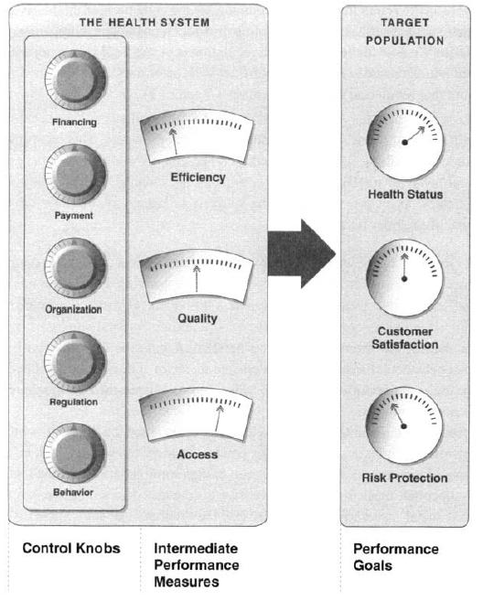
The five control knobs for health-sector reform (Roberts et al, 2004)

Slide 11
Control Knob 1:
Financing

Slide 12
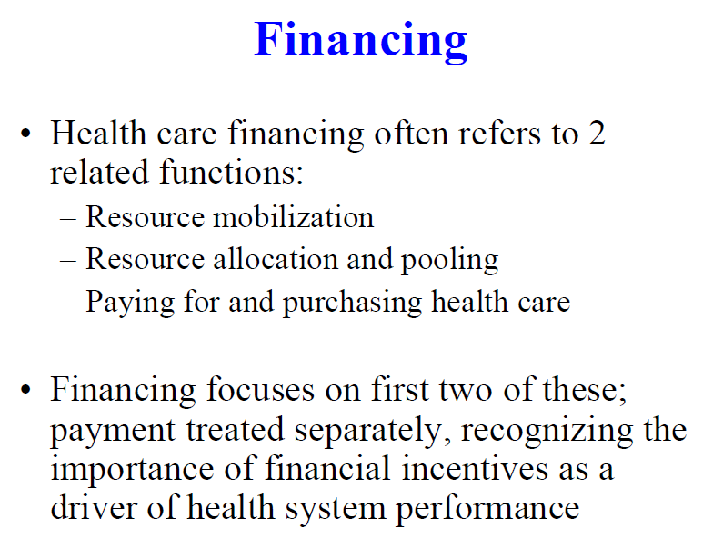

Slide 13
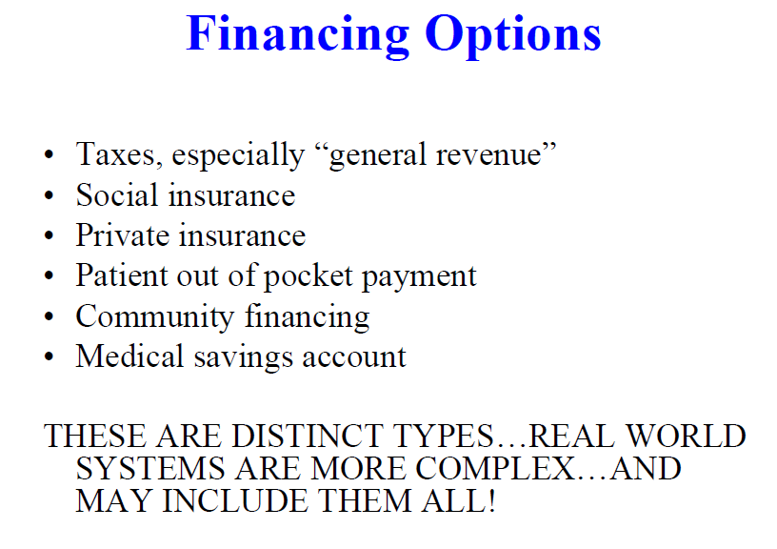

Slide 14
Control Knob 2:
Payment

Slide 15
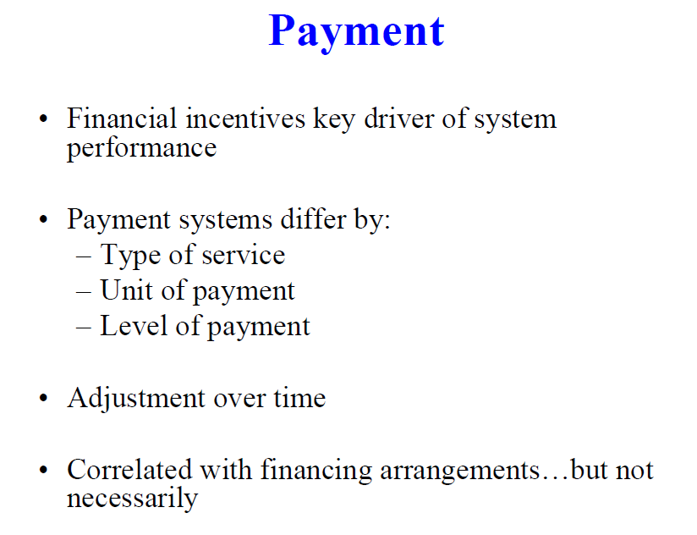

Slide 16
Policy Maker/Manager’s View of the Impact of Different PPMs on Performance Criteria
Group Exercise

Slide 17
Control Knob 3:
Organization

Slide 18
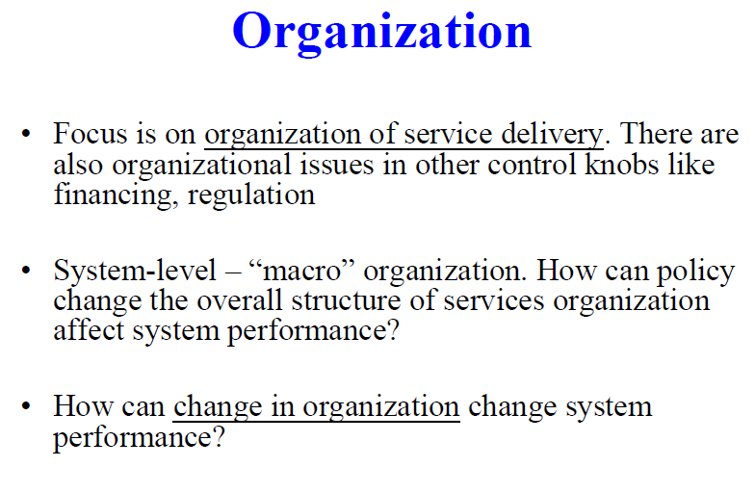

Slide 19
Strategies
􀂃 Definition of service delivery model(s): scope and continuum of care
􀂃 Human resource interventions
􀂃 Innovations in information systems
􀂃 Regionalization strategies

Slide 20
Control Knob 4:
Regulation

Slide 21
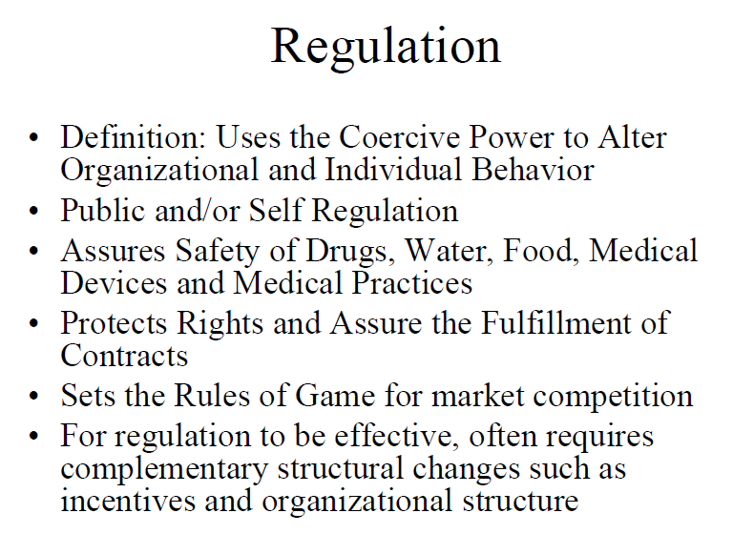

Slide 22
Strategies:
􀂃 Certification, licensing
􀂃 Accreditation
􀂃 Develop national norms and practice standards
􀂃 Legislation re: patients’ rights
􀂃 Regulate insurance companies
􀂃 Separation/redefinition of functions (insuring, financing, providing)
􀂃 Define coordination, cooperation and healthy competition among actors in tri-dimensional system
􀂃 Centralization/decentralization initiatives
􀂃 Develop stewardship/steering capacity
􀂃 Foster essential public health functions
􀂃 Promote awareness about citizen’s rights and responsibilities in healthcare
􀂃 Promote awareness about provider rights and responsibilities

Slide 23
Control Knob 5:
Behavior

Slide 24
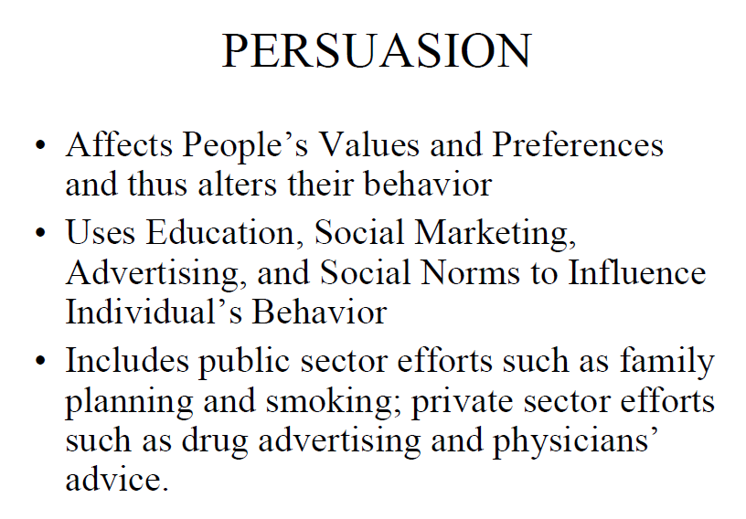

Slide 25
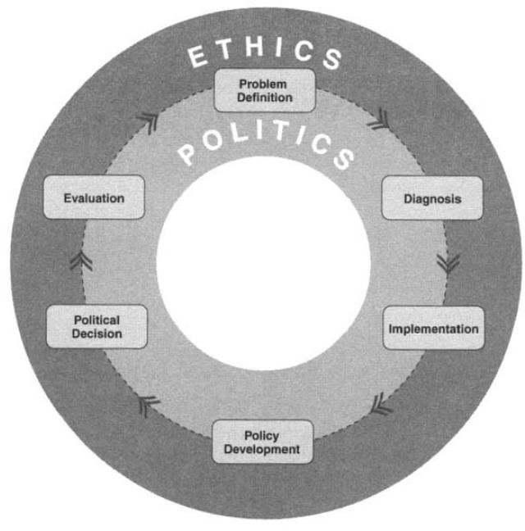
Bagaimana menerapkan Reformasi Kesehatan?
Implementation

Slide 26
Perkembangan Reformasi Kesehatan di Dunia & Indonesia

Slide 27
Perkembangan Reformasi Sektor Kesehatan di Dunia
Muncul referensi:
Getting Health
Reform:
A Guide ….
(Roberts et al)
Inisiatif
Bank Dunia;
IMF
Reformasi Kesehatan:
Aplikasi Mekanisme Pasar
Kurang dukungan teori & evidence-based
Ada yang berhasil; ada yang gagal
1980
2004
Didasari:
- A guide ….
- International experience-
(Benchmarking)
- Inter-Sectoral learning

Slide 28
Reformasi Depkes:
Kepmenkes No. 574/2000 tentang Kebijakan Pembangunan Kesehatan Menuju Indonesia Sehat 2010
Perkembangan Reformasi Sektor Kesehatan
Di Indonesia
Getting Health
Reform:
A Guide ….
(Roberts et al)
Inisiatif
Bank Dunia;
IMF
Reformasi Kesehatan:
Aplikasi Mekanisme Pasar
1980
2000
2004
Inovasi
PMPK
FK UGM
4 Strategi Reformasi Kesehatan Depkes tahun 2000:
1. Pembangunan Berwawsan Kesehatan: 2. Profesionalisme
3. JPKM; 4. Desentralisasi

Slide 29
2. Apakah kebijakan financing saja cukup? Kasus Jamkesmas
Jamkesmas merupakan sebuah kebijalan pembiayaan.
Apakah cukup Jamkesmas?

Slide 30
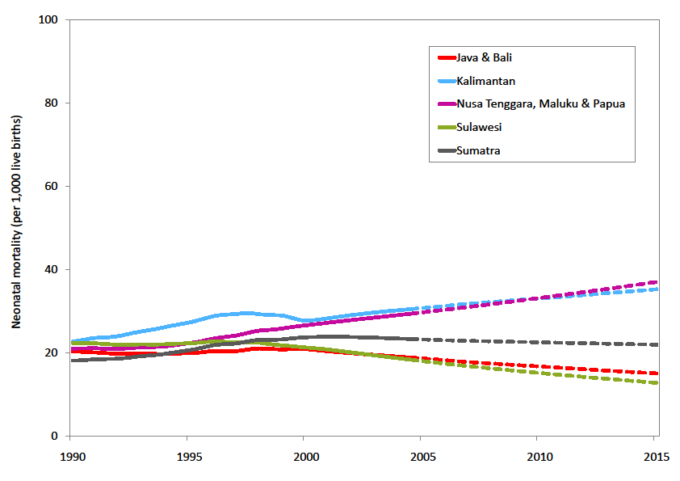
Ada Askeskin, namun ada ketidak adilan geografis.

Slide 31
The Jamkesmas impact Scenario (to be discussed)
In the future:
Can Jamkesmas improve both: socio-economic equity and geographical equity?
Or just improving socio-economic equity?

Slide 32
4 Big Scenarios
+
Socioeconomic equity
4
1
-
+
Geographic
equity
Geographic
inequity
3
2
Socioeconomic inequity
-

Slide 33
Current Situation
+
Socioeconomic equity
-
+
Geographic
equity
Geographic
inequity
Socioeconomic inequity
-

Slide 34
Going there? How is the probability?
+
Socioeconomic equity
-
+
Geographic
equity
Geographic
inequity
Socioeconomic inequity
-

Slide 35
Going there? How is the probability?
+
Socioeconomic equity
-
+
Geographic
equity
Geographic
inequity
Socioeconomic inequity
-

Slide 36
Going there? How is the probability?
+
Socioeconomic equity
-
+
Geographic
equity
Geographic
inequity
Socioeconomic inequity
-

Slide 37
Going there? How is the probability?
+
Socioeconomic equity
-
+
Geographic
equity
Geographic
inequity
Socioeconomic inequity
-

Slide 38
Or going there? How is the probability?
+
Socioeconomic equity
-
+
Geographic
equity
Geographic
inequity
Socioeconomic inequity
-

Slide 39
Jamkesmas current situation
+
Socioeconomic equity
Is good for improving socio-economic equity
WB study shows that there are still rooms for improvement in Jamkesmas management
-
+
Geographic
equity
Geographic
inequity
Socioeconomic inequity
-

Slide 40
2. Policy Options to prevent the bad scenarios
Do nothing: the current situation develop naturally
Increasing budget for Jamkesmas based on per capita calculation, do nothing for reducing the geographic inequity
Increasing budget for Jamkesmas, and trying to reduce geographic inequity

Slide 41
For Policy Option 3
Reducing geographic inequity
What are the relevant policies?
Will be analysed using control knobs of health care reform

Slide 42
WB/Harvard Health Care Reform
Outcomes
Control Knob
Health Status
Financing
Payment
Macro-organization
Regulation
Persuasion
Access
Quality
Efficiency
Community Satisfaction
Cost
Risk Protection

Slide 43
Financing
Increasing Jamkesmas and Jampersal financing
Encouraging local government insurance (Jamkesda)
Improving the efficiency of Jamkesmas and Jampersal
Better allocation in health finance. Give less to the strong fiscal capacity districts
......

Slide 44
Payment
Main Objective:
To overcome the health workforce problem through:
Increasing professional income from Jamkesmas and Jampersal (lowering the gap with “out of pocket” payment)
More incentives for remote area health workforce
Contracting health workforce to work in remote area (the case of NTT Sister Hospital)
......

Slide 45
Organization
Improving the health infrastructure in remote and difficult area for narrowing the gap with developed ones.
Deploying human resource to remote and difficult area
Preventing supplier induced demand in Jamkesmas and Jampersal
Improving health service organization management
....

Slide 46
Regulation
Regulating medical education: affirmative policy for medical students and recidency training enrollment
Fellowships for local people to study in health sciences
.....

Slide 47
Closing remark
Jamkesmas is one of health financing policies as the replacement of Askeskin
Based on Askeskin impact on equity, it is predicted that Jamkesmas impact can be bad for geographical inequity
There are many secenarios for the impact of Jamkesmas; from the best to the worst

Slide 48
Policy options
To prevent the bad scenarios, there should be policy options for supporting Jamkesmas as financing policy:
Improving the human resources through better compensation for health workforce who work in insurance scheme and in remote areas
Developing health infrastructure for achieving a more balance hospital and health center distribution
Increasing the efficiency of Jamkesmas organizational system
Regulating medical education
Using health care reform approach

Slide 49
3. Sister Hospital NTT
Geographic inequity dalam pelayanan kesehatan ibu & anak karena keterbatasan tenaga medis
Tenaga medis khususnya dokter spesialis (obgin, anak, & anastesi) tidak berminat ke kabupaten di NTT
Pendekatan kontrak perorangan tidak efektif; di RSUD hanya fokus pelayanan (tidak mengembangkan sistem)
Dokter umum setempat sulit mengikuti PPDS

Slide 50
Reformasi dalam Program Sister Hospital NTT
Merubah pengorganisasian pelayanan kesehatan melalui kerjasama antar organisasi (model sister hospital); (TOMBOL ORGANISASI)
Merubah sistem pembayaran untuk tenaga kesehatan melalui pendekatan kontrak per kelompok; dan (TOMBOL PAYMENT)
merubah regulasi pelayanan kesehatan ibu dan anak dan pendidikan tenaga kesehatan (spesialis) melalui kebijakan yang affirmative untuk daerah sulit seperti NTT. (TOMBOL REGULASI)

Slide 51
Apa itu Program Sister Hospital NTT?
(Bagian dari Revolusi KIA NTT)
Program kemitraan antara RS “besar” di luar NTT dengan RSUD Kabupaten di NTT
Untuk mengatasi kelangkaan dokter spesialis dan tenaga pendukung lainnya secara jangka pendek dalam pelayanan PONEK 24 Jam di RSUD di NTT
Kerja sama dalam bentuk kontrak (AIPMNH/AusAid) dalam jangka waktu tertentu
Pemrakarsa: Dinas Kesehatan Propinsi NTT; difasilitasi oleh PMPK FK UGM
Pelaksanaan mulai: Juli 2010 – (Juli 2012)

Slide 52
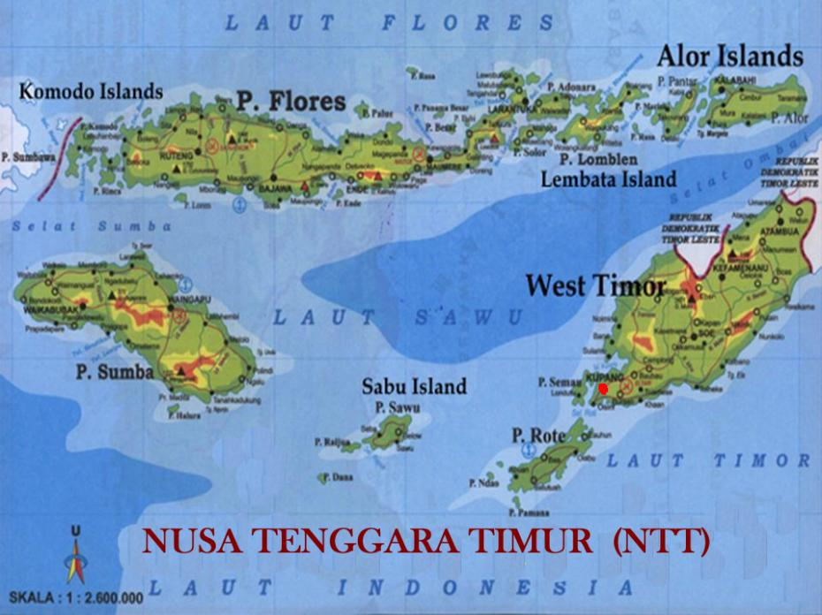

RSWS
RSSA
Bethesda
Panti
Rapih
Sanglah
RSDS

Slide 53
Kegiatan
(1) Kegiatan Kontrak Pelayanan Klinik (Clinical Contracting) dengan RS mitra dalam konsep Hospital Partnership; dan
(2) kegiatan pengiriman pendidikan spesialis.
Kegiatan dilakukan secara paket. RS Daerah yang dibantu dengan pengiriman tenaga dan pembangunan sistem PONEK harus mengirimkan dokter sebagai residen.
Pengiriman tenaga dari RS mitra bersifat sementara

Slide 54
Kegiatan Clinical
Contracting Out
Tujuan: Meningkatkan kemampuan rumah sakit dalam hal pelayanan kesehatan ibu dan anak PONEK melalui:
      Pengiriman dokter spesialis obstetri-ginekologi, dokter spesialis kesehatan anak, dan tenaga paramedis pendukung untuk melakukan pelayanan kesehatan ibu dan anak;
      Peningkatan ketrampilan teknis staf di rumah sakit melalui pelatihan dan pembudayaan teknis kerja dalam kegiatan sehari-hari
      Pelatihan tim tenaga di Puskesmas dalam rangka penguatan sistem rujukan kesehatan ibu dan anak (mengembangkan hubungan PONED dan PONEK)

Slide 55
Kinerja Klinis 6 bulan di 6 RS Mitra
Variabel | Intervensi |  |  |  |  |  |  |  |  |  |  |  | Intervensi
 | RSWS¹ |  | RSDS² |  | RSSA³ |  | Sanglah⁴ |  | Panti Rapih⁵ |  | Bethesda⁶
 | Pra | Pas ca | Pra | Pas ca | Pra | Pas ca | Pra | Pas Ca | Pra | Pas ca | Pra | Pasca | To-tal Pra | To-tal Pas-ca | %
Jumlah partus normal | 728 | 430 | 206 | 251 | 280 | 288 | 119 | 193 | 502 | 409 | 355 | 447 | 2190 | 2018 | -7,85
Jumlah partus per vaginal dengan komplikasi | 6 | 21 | 0 | 26 | 52 | 24 | 31 | 19 | 13 | 22 | 11 | 26 | 113 | 138 | 22,12
Jumlah SC | 121 | 94 | 0 | 94 | 133 | 136 | 133 | 177 | 252 | 170 | 92 | 190 | 731 | 861 | 17,78
Jumlah Kematian Ibu | 1 | 1 | 1 | 3 | 2 | 0 | 0 | 0 | 4 | 1 | 6 | 1 | 14 | 6 | -57,14
Jumlah Kematian Neonatus | 32 | 4 | 9 | 7 | 5 | 9 | 10 | 14 | 25 | 15 | 23 | 13 | 104 | 62 | -40,38
Jumlah IUFD | 27 | 8 | 22 | 26 | 4 | 7 | 10 | 22 | 33 | 26 | 20 | 0 | 116 | 89 | -23,28

Slide 56
RSWS
RSCM
RS
Kariadi
RSSA
RSDS
RSS
Panti
Rapih
Sanglah
RSIA
HK

Slide 57
Terima kasih

